Slide 1

ENTERPRISE SOFTWARE DEVELOPMENT

Slide 2
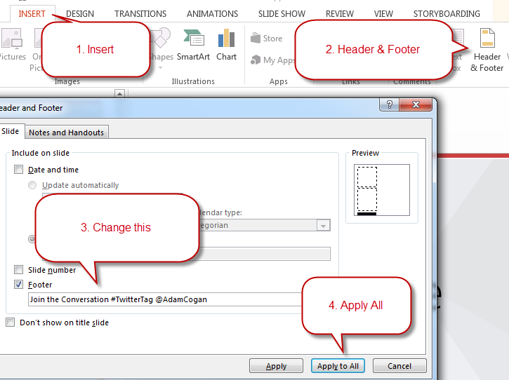
Change the Footer
Make sure you don’t forget the footer. Everyone forgets the footer.
TIP: If your content interferes with the footer you can slide it to one side.

Slide 3
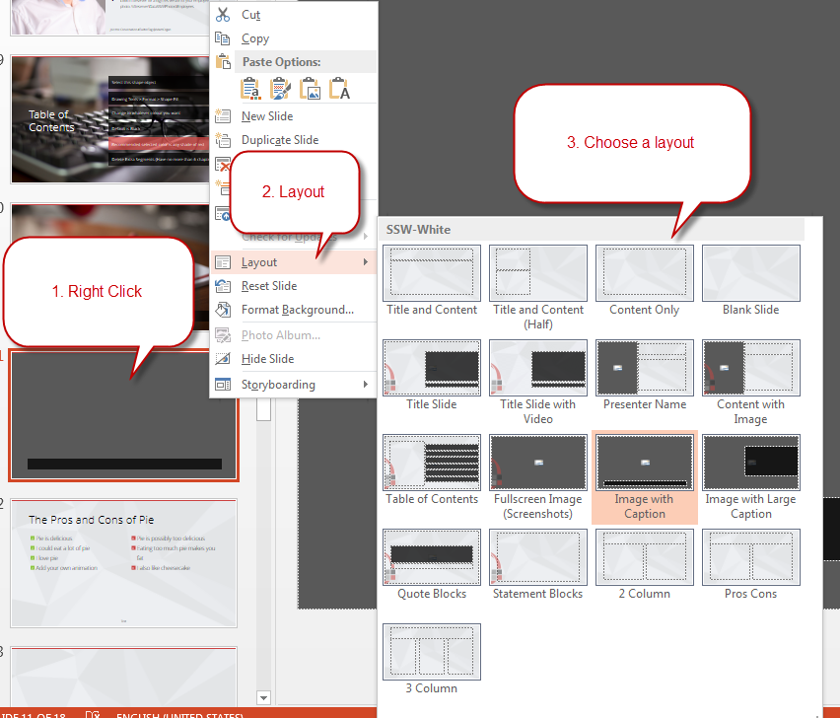
Use Different Slide Layouts
Make sure you’re using the template correctly with slide layouts.

Slide 4
SSW Template
Version 4.0 by SSW Design Tip: Slides have additional info in View | Notes.
Notes:
V4.0 Beautified by Jayden

Slide 5
















Icon Library
These icons are pulled from http://fontawesome.com
Feel free to use your own by pasting in any SVG. You can use PowerPoint to recolor SVGs (Right Click > Fill).

Slide 6




Other Icons
Here are some little red people and other items!
ssw.com.au/rules/do-you-use-standard-question-mark-when-you-are-going-to-ask-the-audience-something
Question Man Demo Man Bad Example Good Example

Slide 7

Adding logo watermark
If you want the logo overlap as shown in the template, you’ll need the logo in the bottom right of this slide. Just copy paste it onto relevant slides.

Slide 8

Vercel - Simplifying Your Development with Zero Configuration
.NET UG - October 2023

Slide 9
Tylah Kapa
SSW Software Engineer
@JadeKapa
https://www.linkedin.com/in/tylah-kapa/
Broke an arm while arm-wrestling
Bad at kickboxing
Collects expensive cardboard

Slide 10
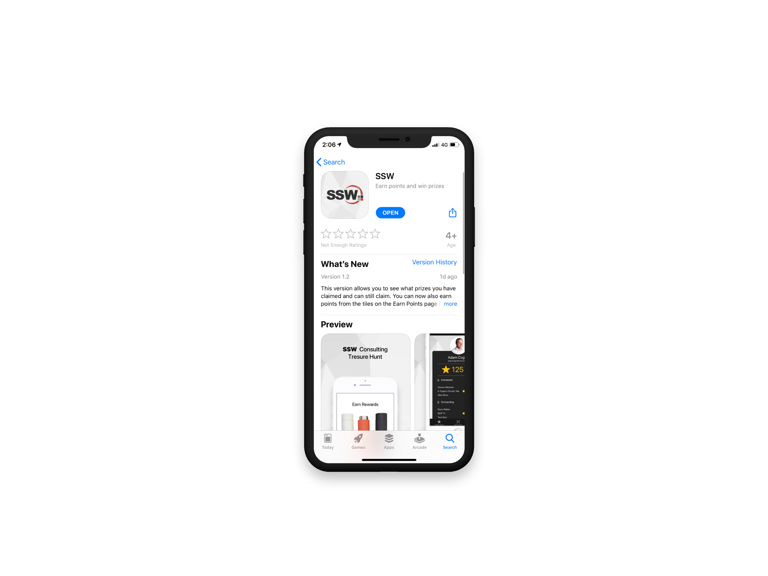

Scan QR Code to install app
Scan SSW codes at talks and events
Earn SSW Points
claim rewards, and win prizes
SSW Rewards
Notes:
An SSW Admin will give you your QR code https://my.sugarlearning.com/SSW/items/13946/ssw-rewards-setup-the-ssw-rewards-app

Slide 11


Agenda
1. What started this journey?
2. What is Vercel and NextJs?
3. Vercel Demo
4. How does Vercel compare?
5. Summary

Slide 12
What started this journey?

Slide 13
Have you ever failed to launch on a side project?

Slide 14
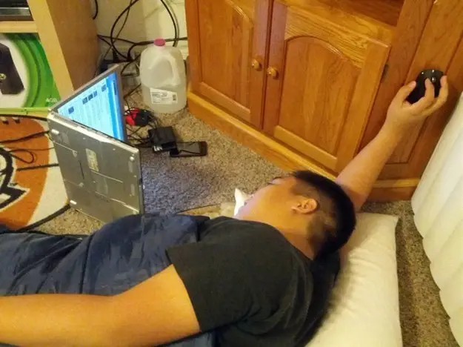
Requirements
Blog site
Easy to stand up
Easy to maintain and update
Good analytics
Static Site Generation
$FREE.99
Notes:
Wanted a Blog:
Easy to stand up
Easy to update
No maintenance
FREE

Slide 15

”How would I do that?”
Azure
Create Repo
Create Azure Resources
(Static Web App, App Insights etc.)
Setup GitHub Actions
Debug
Sadness
Notes:
How would I do that with Azure?
Create Repo
Create Azure Resources
(Static Web App, App Insights etc.)
Setup GitHub Actions
Debug
Sadness

Slide 16
What is Vercel?
End-to-end platform
Deployments
CI/CD
Analytics
Edge Functions
Notes:
End-to-end platform
Deployments
CI/CD
Analytics
Edge Functions

Slide 17
What is NextJs?
React Framework
Create fast SEO React Apps
SSG, SSR, ISR
Fully integrated with Vercel

Slide 18









and more…

Slide 19
How can you use Vercel?

Slide 20
Where does Vercel Stand?
Scalability
Performance
Edge functionality
Ease of use
Focus on development
Incredible free features
(Mostly) Locked into NodeJs
Front-End focus
Less CI/CD opportunity
Collaboration is Pro only
Notes:
Pros:
Scalability – Being able to take these apps, and even create multi-tenant applications
Performance – You’ve seen how quickly you can iterate using Vercel
Edge Functionality – Being able to run functions closer to your end user to take advantage of Vercel’s Edge Functions
Ease of Use – You’ve seen just how easy it is to get started with Vercel
Focus on Development – You can just focus on getting your app feature complete with minimal effort
Suite of free features – It’s crazy what you can get for free using Vercel
Cons:
(Mostly) Locked into NodeJs
Front-End focus and Less CI/CD Opportunity – If you’re looking to improve in back-end or CI/CD, Vercel may not be for you
Some awesome features locked behind Pro – I.E. Collaboration.

Slide 21
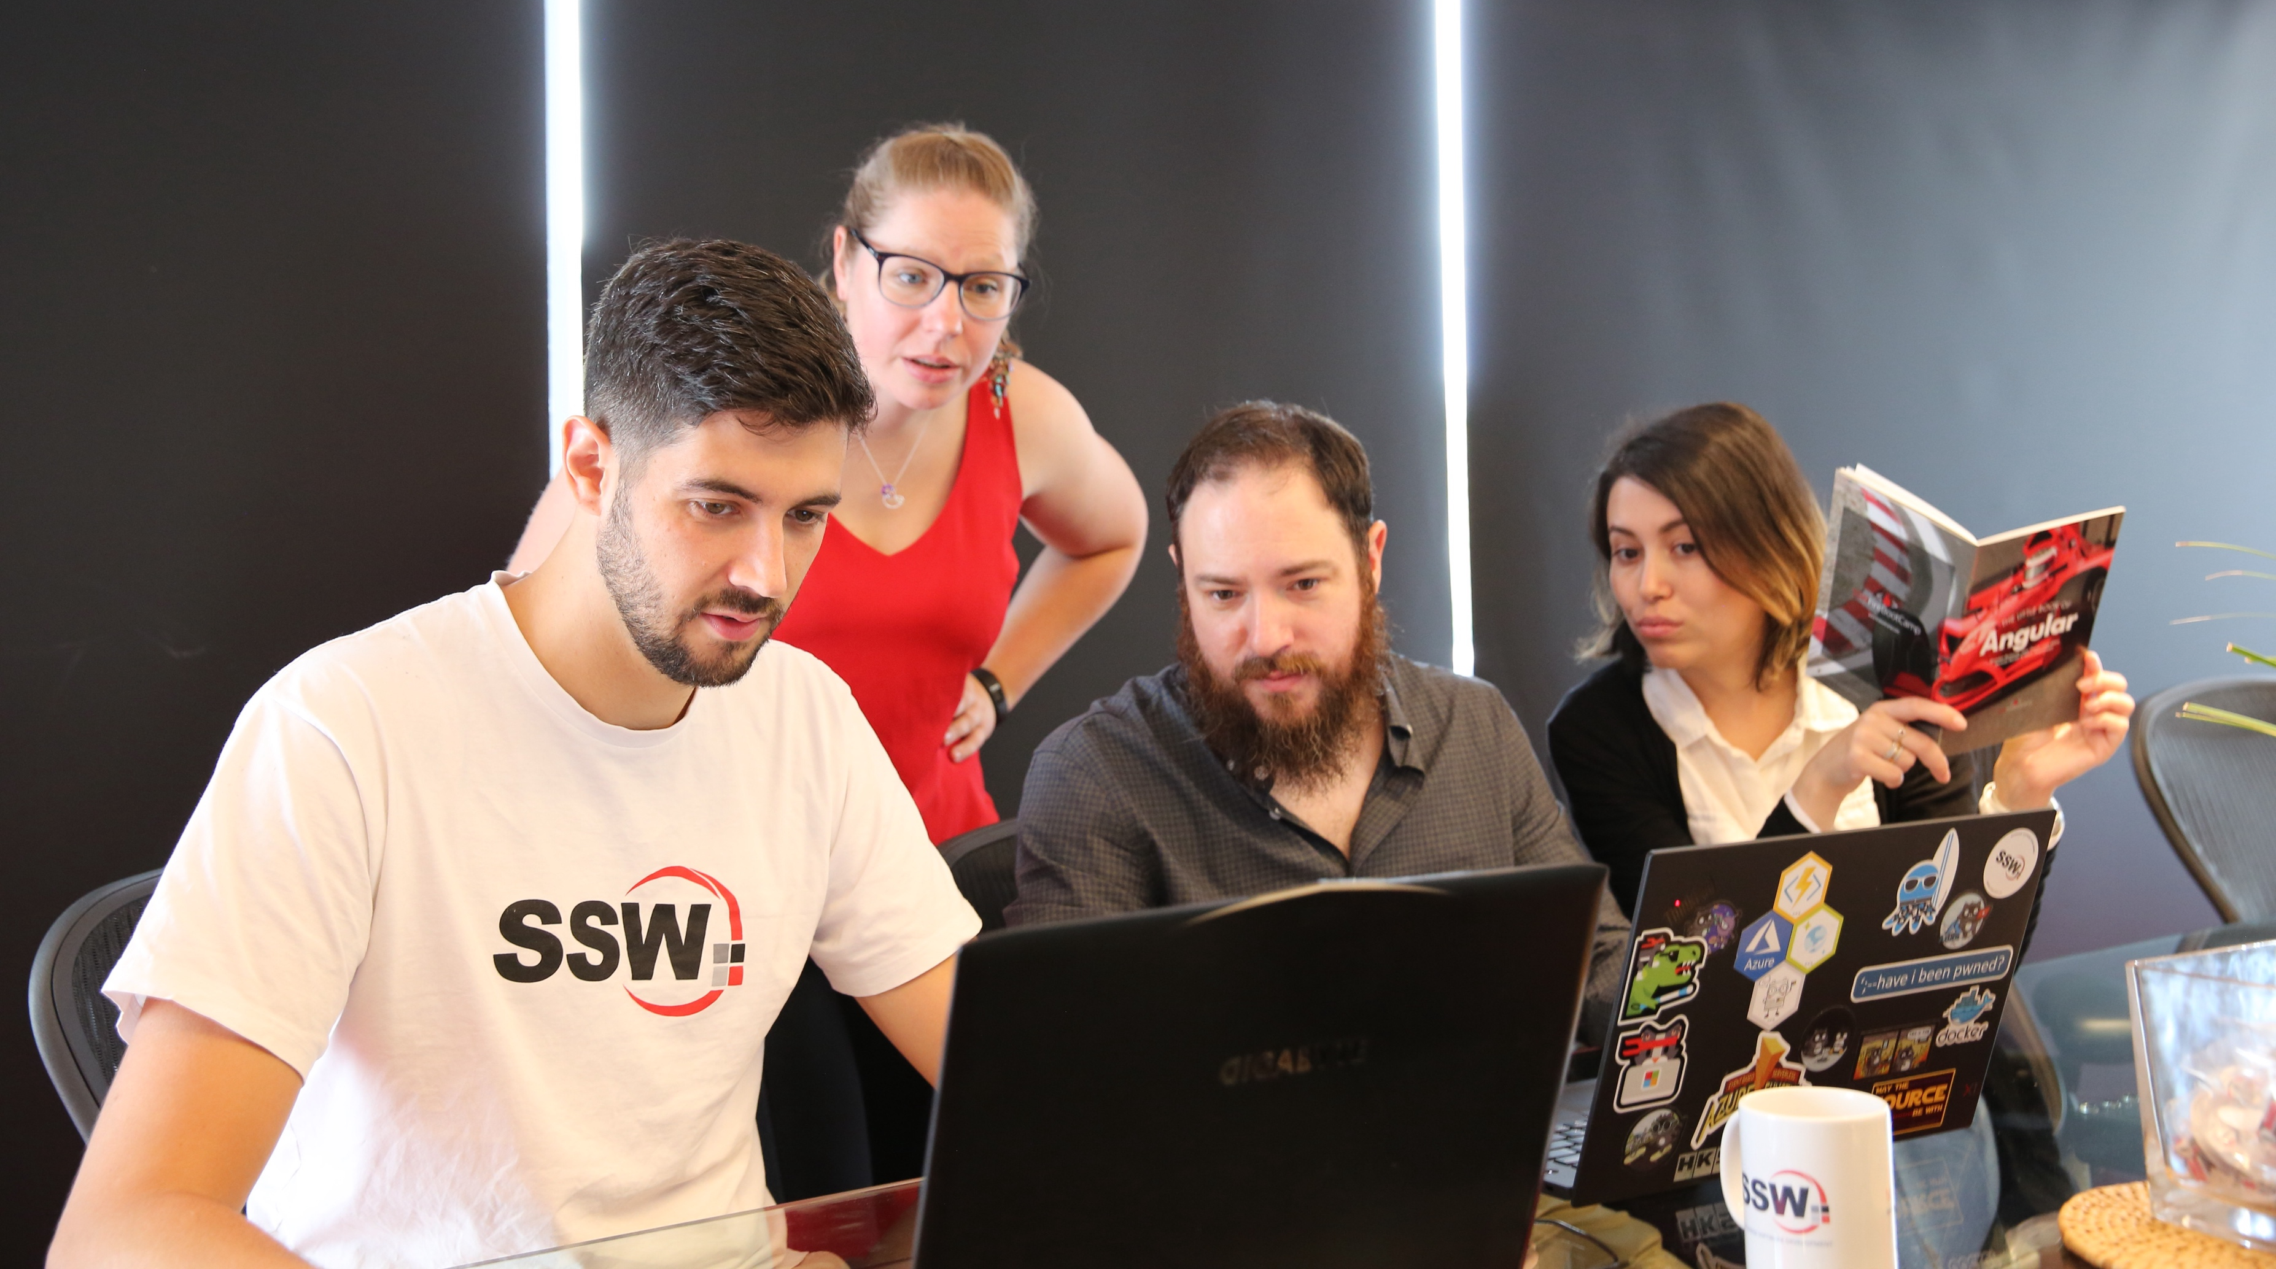
SSW Stock Images – \\fileserver.sydney.ssw.com.au\DataSSW\Photos\Powerpoint-StockImages
Notes:
https://www.ssw.com.au/rules/use-creative-commons-images

Slide 22
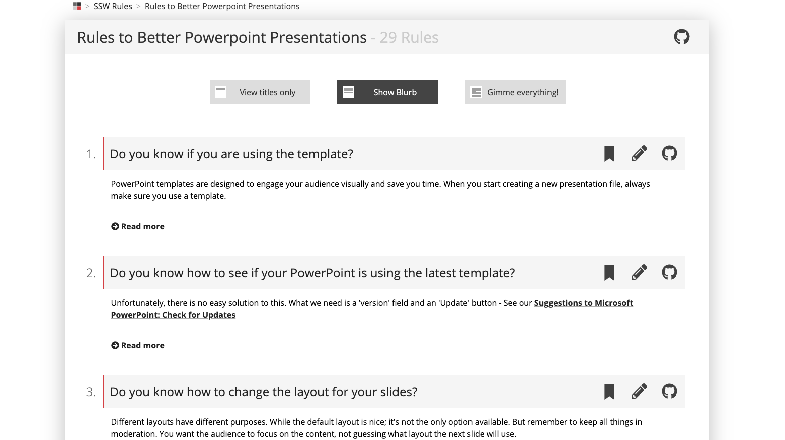
Are you following Rules to Better PPT?
Notes:
https://www.ssw.com.au/rules/rules-to-better-powerpoint-presentations

Slide 23

“Leave audiences with a memorable quote. Think about an important point in your presentation and use it in this layout.”
- Adam Cogan, This Very Slide

Slide 24
“Unfortunately, we no longer have an excuse to not get those side projects going."
- Tylah Kapa, tiredly
Notes:
I’m sorry to inform you that now:

Slide 25
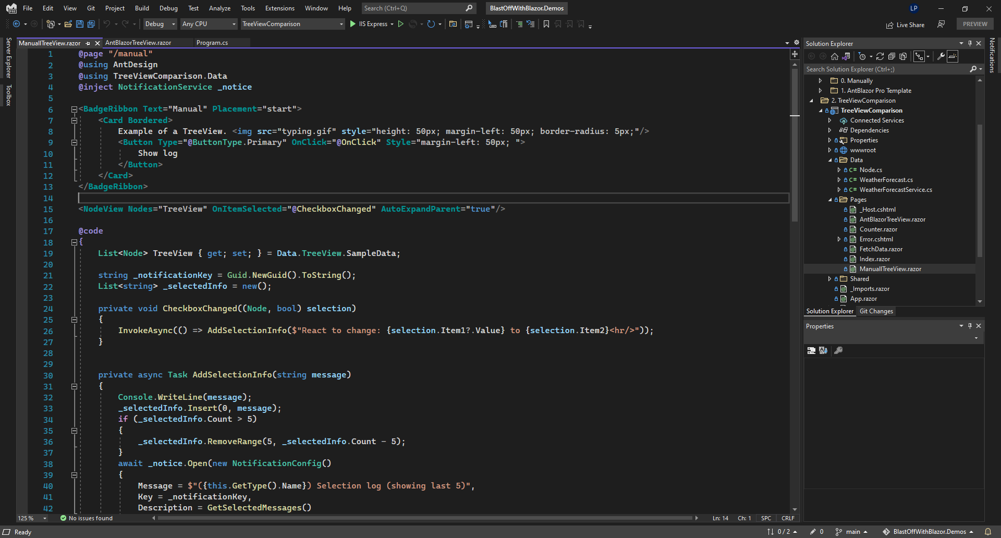
Notes:
Make sure your screenshots are full screen and taken at 125% browser zoom.
https://www.ssw.com.au/rules/do-you-use-the-full-slide-for-screenshots
Use dark mode if you’re cool (keeping with SSW colors).

Slide 26
Indenting Text
If you press tab
While selecting the text
You can indent it
Without adding bullet points

Slide 27
The Pros and Cons of Pie
Pie is delicious
I could eat a lot of pie
I love pie
Add your own animation you lazy buggers
Pie is possibly too delicious
Eating too much pie makes you fat
I also like cheesecake
Notes:
https://www.ssw.com.au/rules/have-good-and-bad-bullet-points

Slide 28
Cake versus Pie
Cake
Sweet
May contain cream
Sometimes contains nuts
Pie
Savoury…. Usually
May contain meat and gravy
Doesn’t usually have nuts

Slide 29
Cake versus Pie versus…
Cake
Sweet
May contain cream
Sometimes contains nuts
Pie
Savoury…. Usually
May contain meat and gravy
Doesn’t usually have nuts
Potato
I love potatoes

Slide 30
This slide has no title, it’s basically made for a huge block of text. You can style this however you want.
With a custom style, the boring slide is now super classy

Slide 31


This is a blank slide
Mainly for drawing shapes or small screenshots
You can do anything you want on this slide

Slide 32
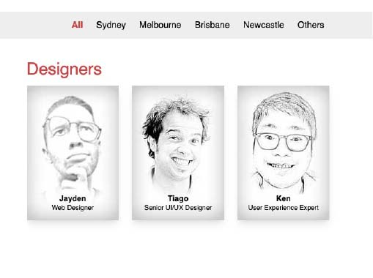
Has a designer done a Test Please on your slides?
This layout is made for a screenshot with some descriptive text. A brave Designer did this so you wouldn’t have to.
Notes:
https://www.ssw.com.au/rules/conduct-a-test-please-internally-and-then-with-the-client

Slide 33

Has a designer done a Test Please on your slides?
This layout is made for a screenshot with some descriptive text. A bave Designer did this so you wouldn’t have to.
Notes:
If you’re interested in learning more:

Slide 34
Resources
Vercel Documentation
vercel.com/docs
Migrating from Gatsby to NextJs – Daniel Mackay
dandoescode.com/blog/migrating-from-gatsby-to-nextjs
Next.js in 100 Seconds // Plus Full Beginner’s Tutorial
youtube.com/watch?v=Sklc_fQBmcs
Notes:
Tip: Resources indicates that you’re nearing the end of your presentation

Slide 35


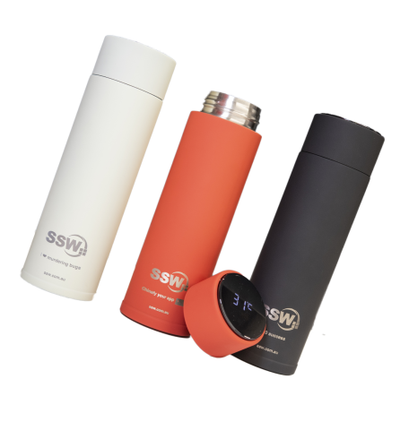

Scan the QR code below and earn
SSW Points for watching this talk!

Slide 36
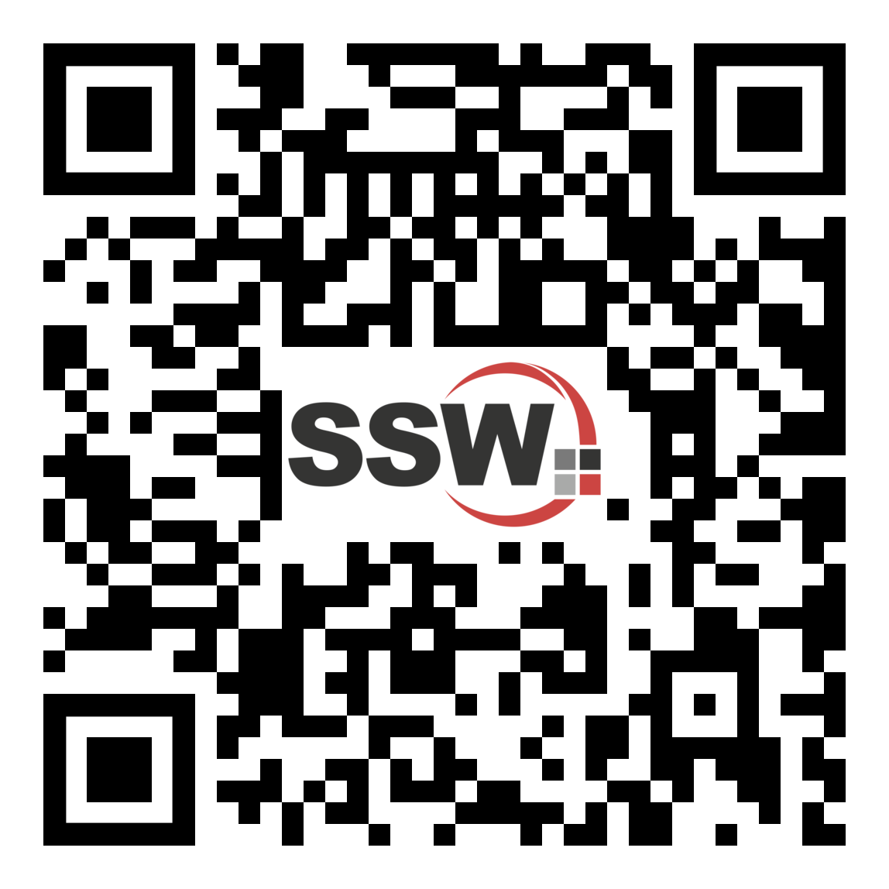
Got feedback?
Scan the QR code here
to fill our survey.
Vercel – Simplifying your Development with Zero Configuration with Tylah Kapa

Slide 37
Summary
1. What started this journey?
2. What is Vercel and NextJs?
3. Vercel Demo
4. How does Vercel compare?
5. Summary

Slide 38
Find this presentation on GitHub!
github.com/tkapa/oct-ug-ppt
Notes:
https://www.ssw.com.au/rules/do-you-keep-your-presentations-in-a-public-location
Example slides: https://github.com/Hona/BlastOffWithBlazor.Demos/raw/main/Presentation.pptx

Slide 39

Thank you! info@ssw.com.au www.ssw.com.au Sydney | Melbourne | Brisbane | Newcastle
Notes:
Note: You should say “thank you” and then pause for 4-5 seconds… to give the audience time to applaud!
https://www.ssw.com.au/rules/do-you-finish-your-presentation-with-a-thank-you-slide

Slide 40
Questions? info@ssw.com.au www.ssw.com.au Sydney | Melbourne | Brisbane | Newcastle
Notes:
Note: You should pause for applause here!
https://www.ssw.com.au/rules/do-you-finish-your-presentation-with-a-thank-you-slide

